Slide 1
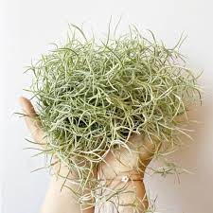
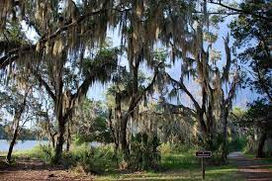
Potential Effects of Endophytes in Tillandsia usneoides
Annika Revis
Faculty Advisor: Dr. Catherine Gehring, Ph. D.
Department of Biological Sciences
Northern Arizona University - Flagstaff, Arizona

Slide 2
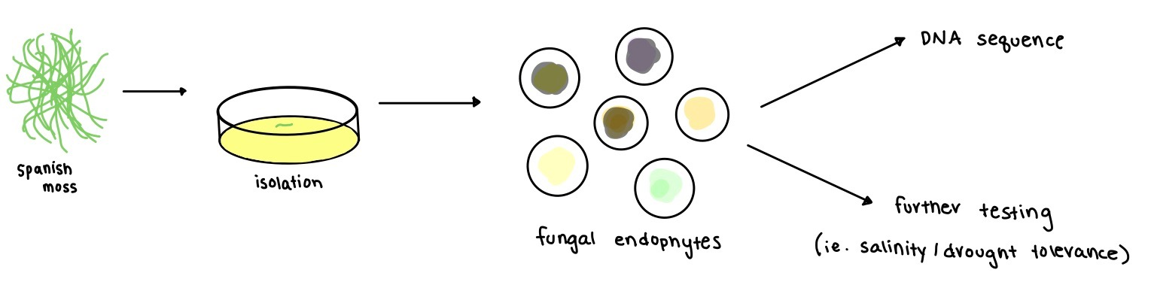
Introduction
-Endophytes are fungi or bacteria that live inside plants.
-They have been known to potentially alleviate plant abiotic or become pathogenic.
-There is also potential they they lay dormant until the plant dies when they begin decomposition and be the first ones there.
-Purpose of researching them is to find out what their purpose is inside of the plant.

Slide 3
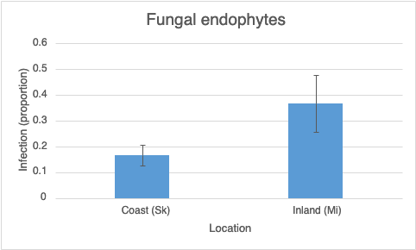
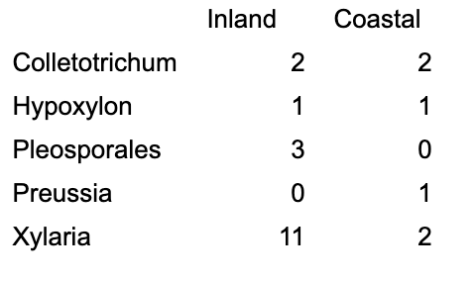
Background
# of Fungal Endophytes Isolated from Each Location
Samples of Spanish moss were taken on a gradient between Skidaway Island and mainland Georgia
Both fungal and bacterial endophytes were isolated.
Several of the fungal endophytes were DNA sequenced to figure out the genus of the species isolated.

Slide 4
How do the endophytes isolated from the Tillandsia usneoides respond to different environmental stressors?

Slide 5
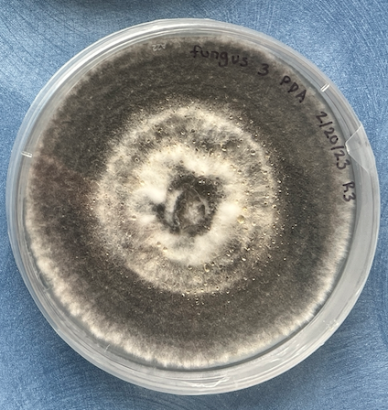
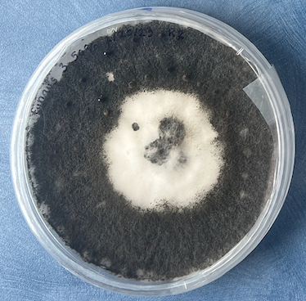
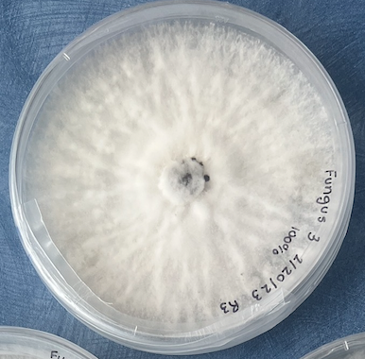
Salinity - 50% Conc. Seawater , 100% Conc. Seawater , Control
Species:
Xylaria multiplex (Mainland)
Biscogniauxia (Mainland)
Xylaria apiculata (Island)
Colletotrichum sp1 (Island)
Xylaria sp2 (Mainland)
Control (PDA)
50% Conc. Seawater
100% Conc. Seawater
5 species of fungus
3 treatments
5 replicates

Slide 6
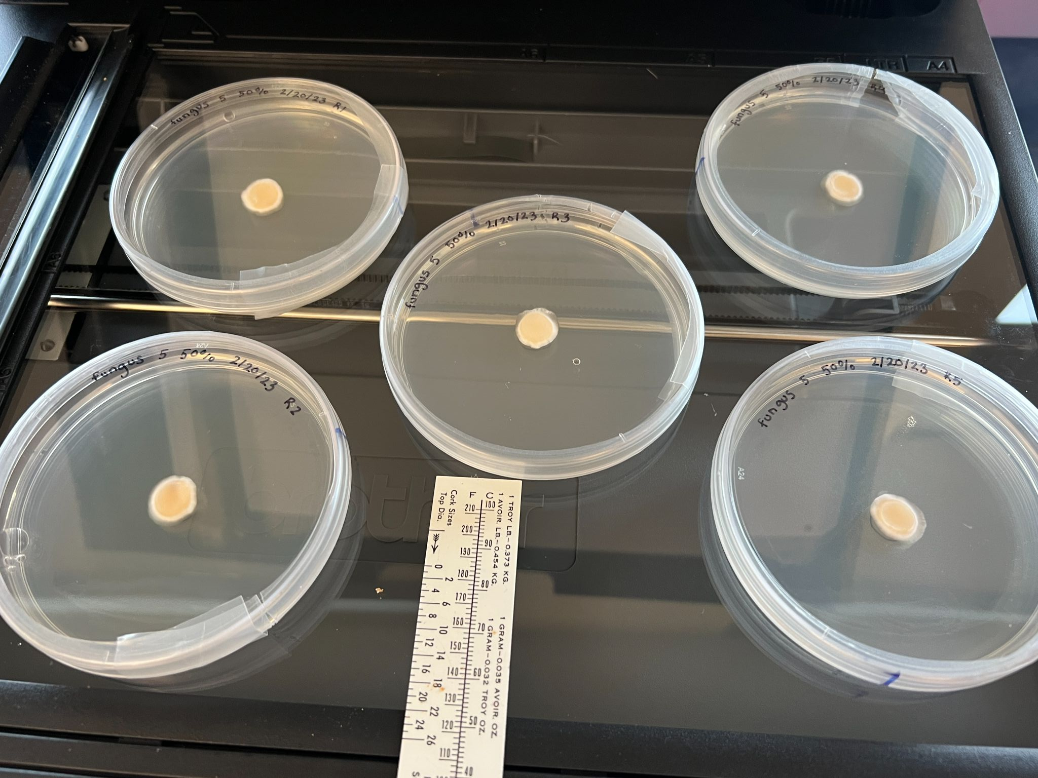
Methods
Fungi were measured for 8 days of growth.
Scanner and Fiji (Image J) used to calculate the area of fungus each day.
Growth rates of the five fungal species in the three salinity levels were compared.

Slide 7
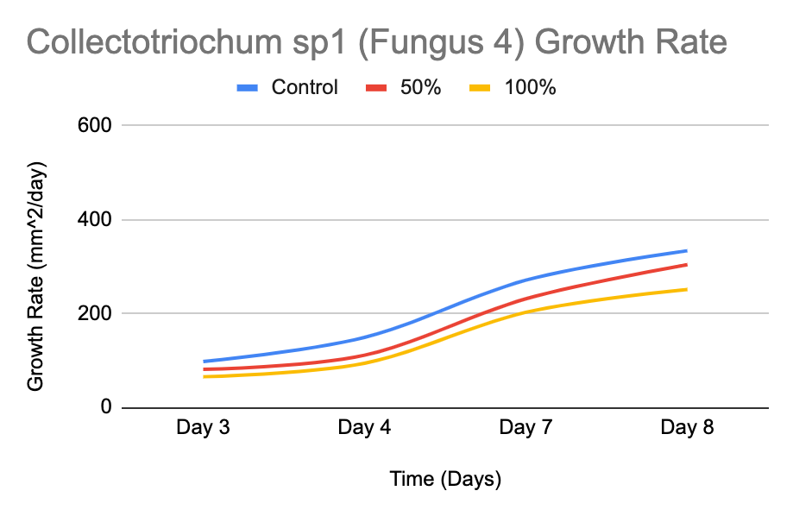
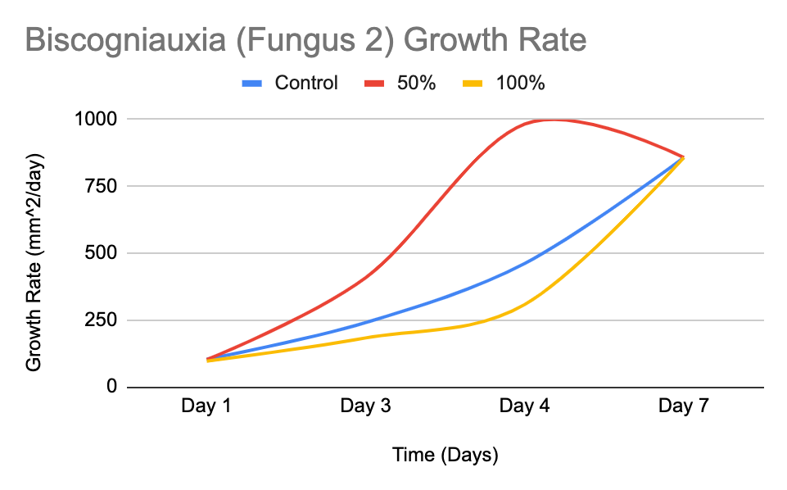
Findings/Data
We hypothesized that each fungus would grow similarly to Fungus 4 the Collectotriochum sp1 with the control having the best growth followed by the 50% then the 100%, however, this was the case for only two species.
Fungus 2 the Biscogniauxia is a good example of a fungus that did not respond in the way we originally thought it would.

Slide 8
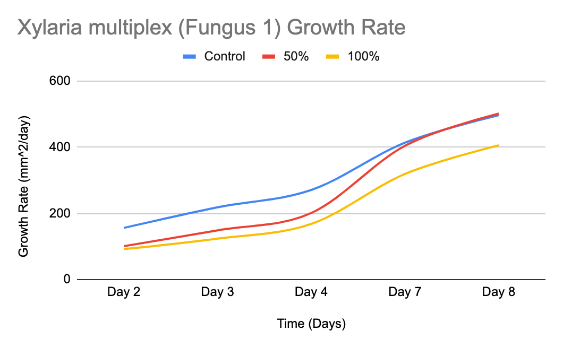
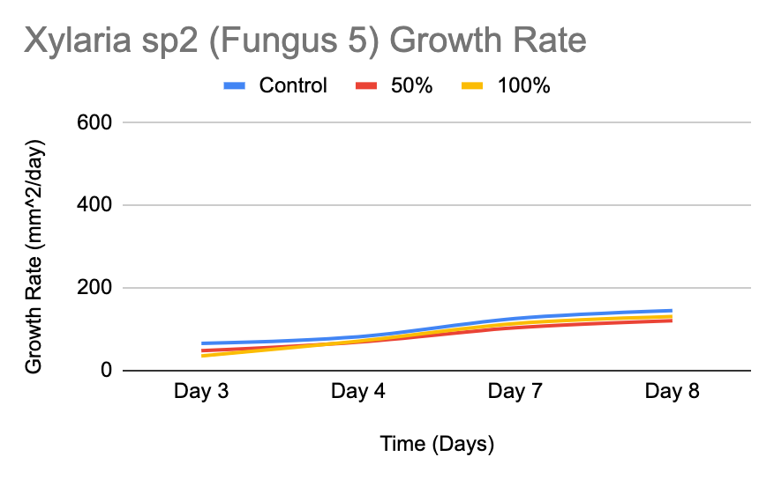
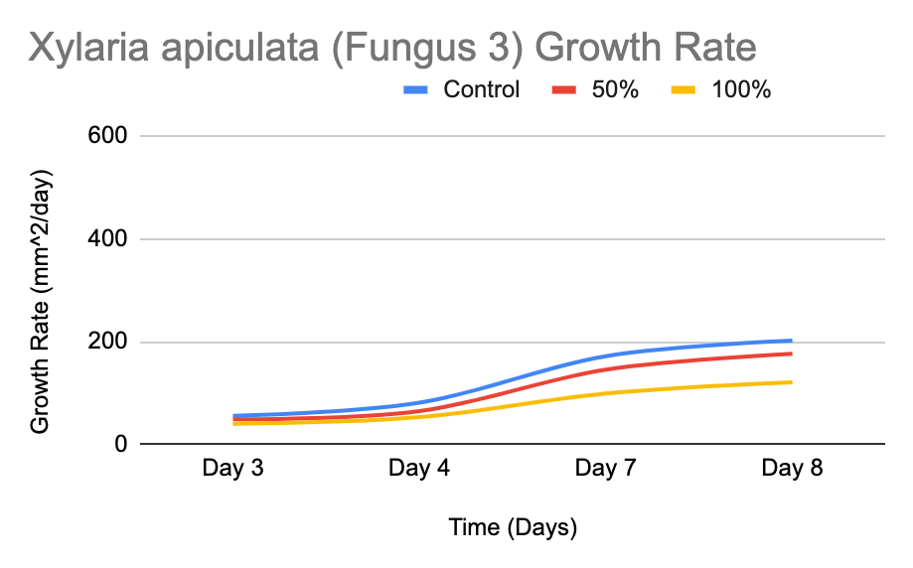
Findings / Data
Fungal endophytes from the same genus had significantly different results.
F5 and F3 were the most similar of the 5 types of fungus.

Slide 9
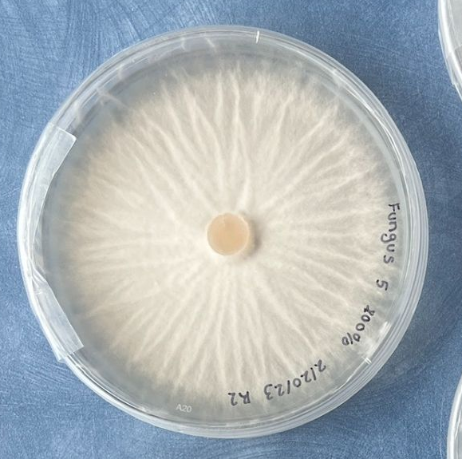
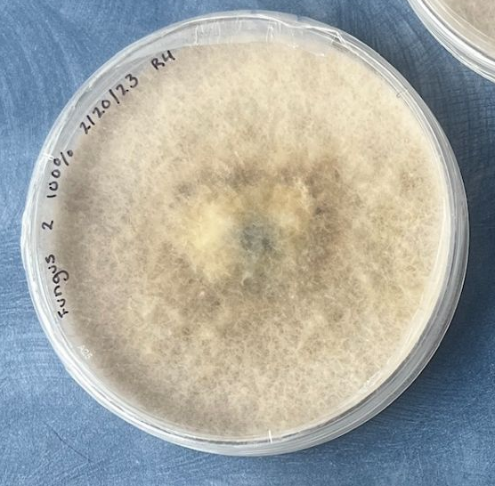
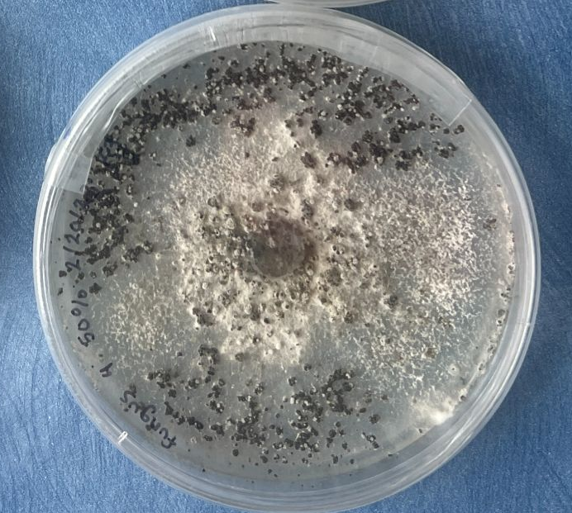
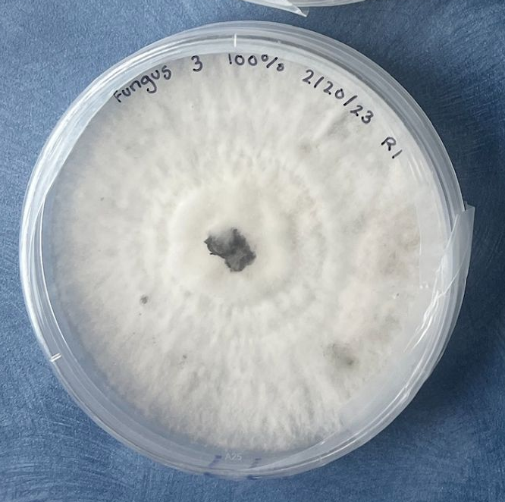
Conclusion
-The species of fungus affects growth more strongly than the salinity of the media.
-50% Conc. Seawater behaves similarly to the control and growth is mainly inhibited with 100% Conc. Seawater media.
-The source location of the fungal endophyte plays very little role in tolerance to salinity

Slide 10
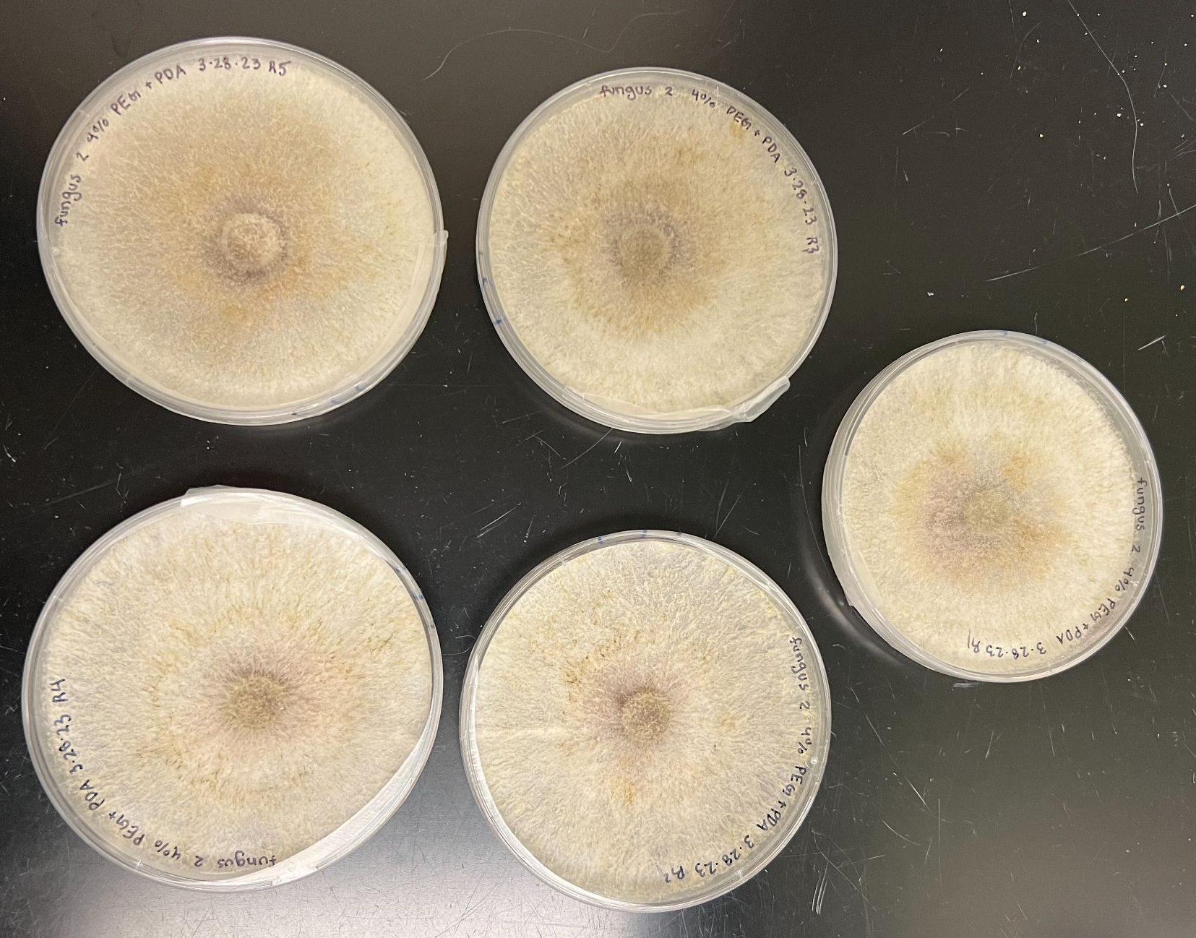
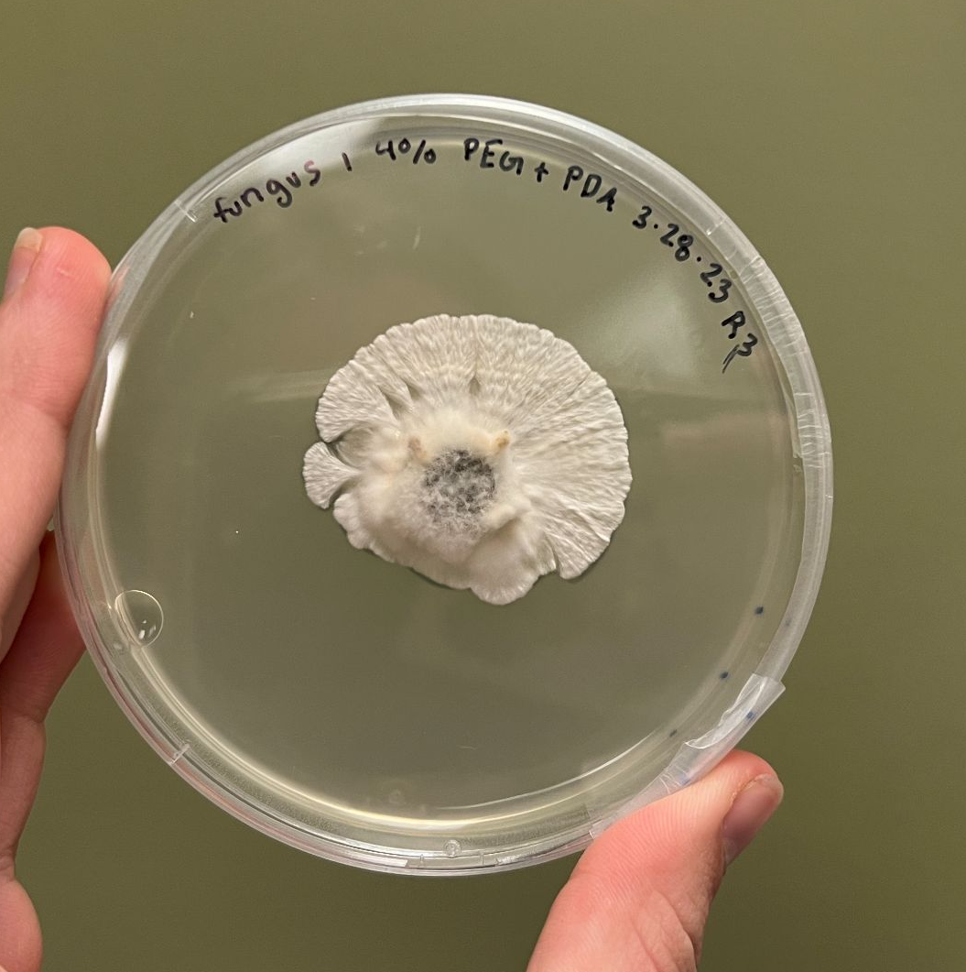
Continued Research
-Drought trials have been completed using 4% PEG + PDA media
-We will continue to compare the tolerance to salinity to the tolerance to drought to see if there is any correlation.
-We will continue to compare the melanin production and reproductive structures to the media present as well.

Slide 11


Acknowledgements
Dr. Catherine Gehring (Ph.D.)
Dr. Ron Deckert (Ph.D)
The Gehring Lab Group
NASA Space Grant Program

Slide 12
Questions?

Slide 13
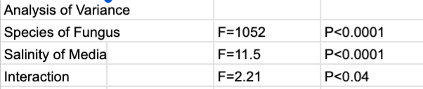
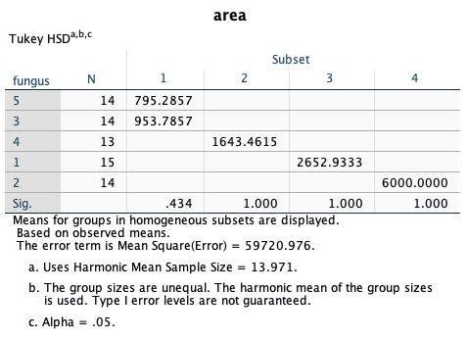
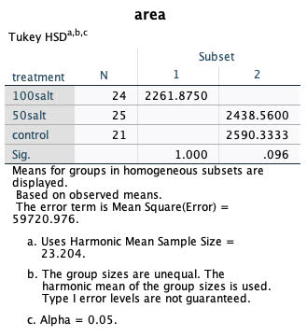
Extra Statistics
Notes:
To flip to just in case someone asks.

